Slide 1
MIS 550 Big Data Analytics & Visualization week 7 assignment Shubham Patil WU0246361

Slide 2
Covid 19 Data Set

Slide 3
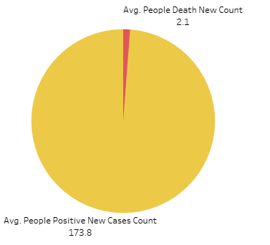
Mean – Average Distribution of COVID-19 Cases and Deaths
The graph presents average COVID-19 positive case numbers and death data through a pie chart format. The average number of new positive cases stands at 173.8 while new death cases remain very low with 2.1 as the mean value. The graphic demonstrates the major difference between COVID-19 infection rates and death rates because numerous people tested positive but the number of fatal cases remained low.

Slide 4
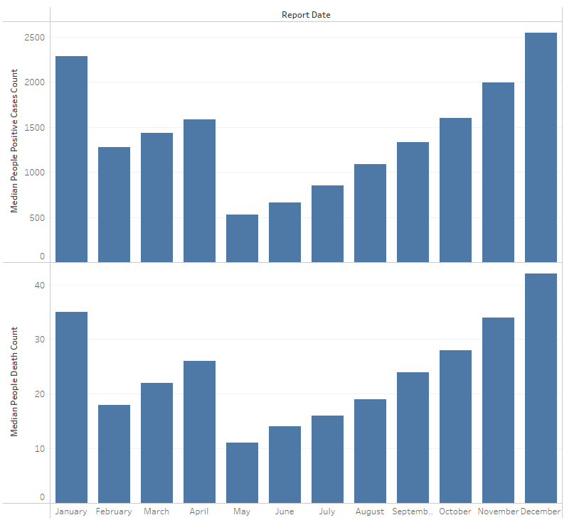
Median – Monthly Median Distribution of COVID-19 Cases and Deaths
The presented chart reveals COVID-19 case and death data by month which demonstrates elevated numbers in January and December. The data shows strong upward trends for both metrics during the latter period of the year which demonstrates seasonal increases.

Slide 5
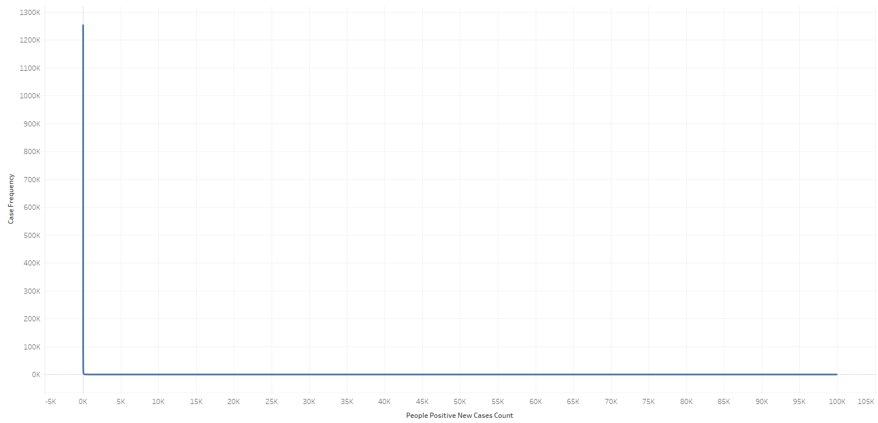
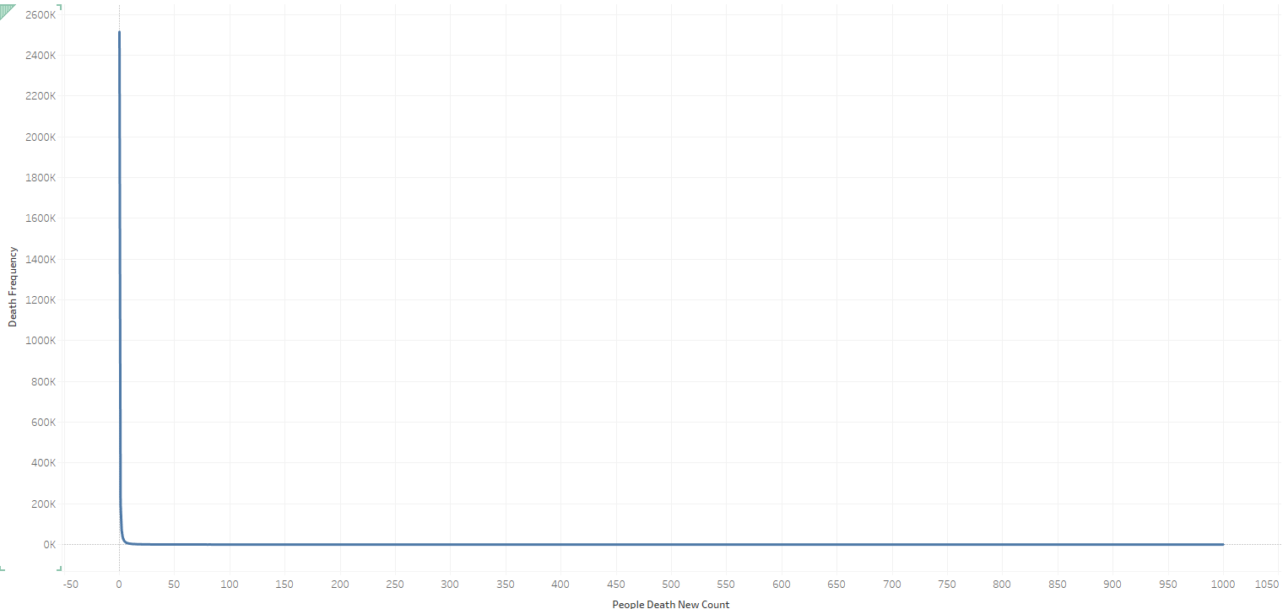
Mode - Distribution of COVID-19 Cases and Deaths
These histograms show that the most frequently occurring values (modes) for both new COVID-19 case counts and death counts are near zero. This indicates that on most days, regions reported either very few or no new cases and deaths, with higher values appearing as rare outliers.

Slide 6
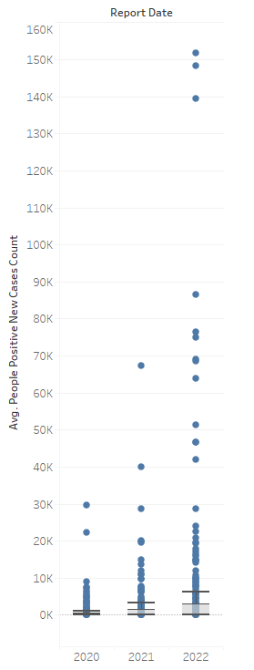
Quartile Distribution of COVID-19 Cases per Year
The yearly average new COVID-19 case counts are shown through this box-and-whisker plot which displays the quartiles and outliers during the period from 2020 to 2022. The majority of data points occur in the lower sections of the distribution but two extreme outliers in 2021 and 2022 demonstrate the high case numbers during pandemic surges.

Slide 7
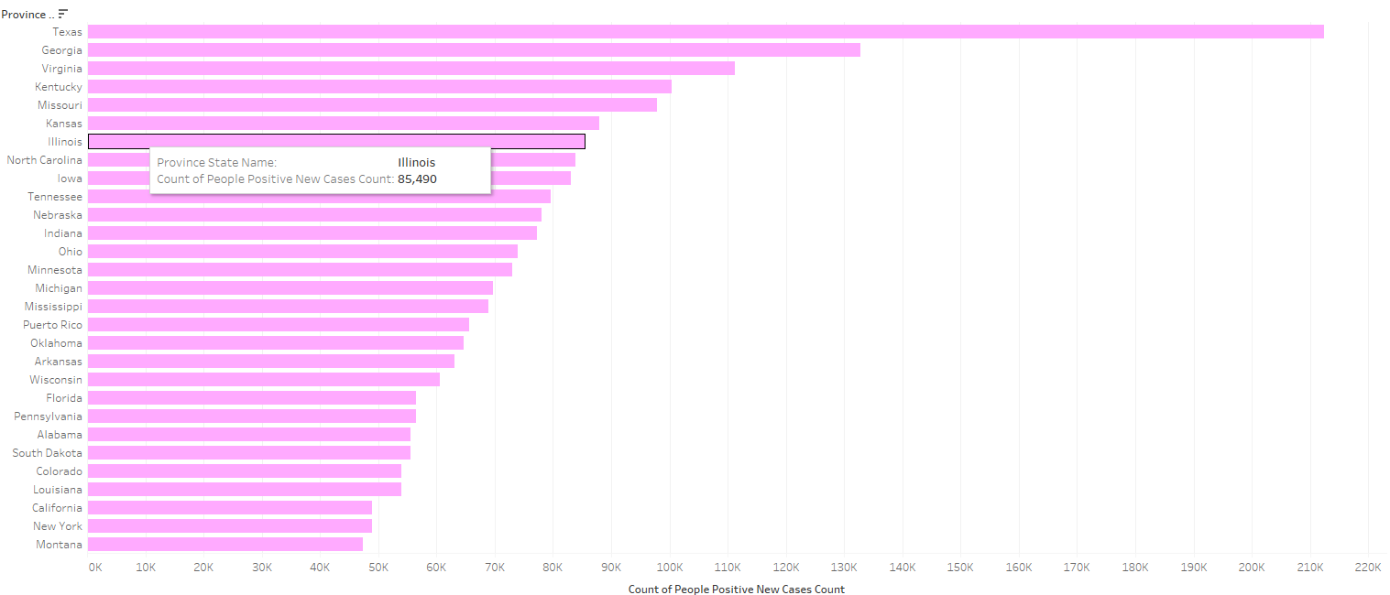
Pivot Table – Top 30 State wise Distribution of Case Counts
The horizontal bar chart displays U.S. state COVID-19 positive cases and Texas and Georgia lead with the most reported cases. The presentation reveals how states differ greatly in their COVID-19 case numbers throughout different regions of the country.

Slide 8
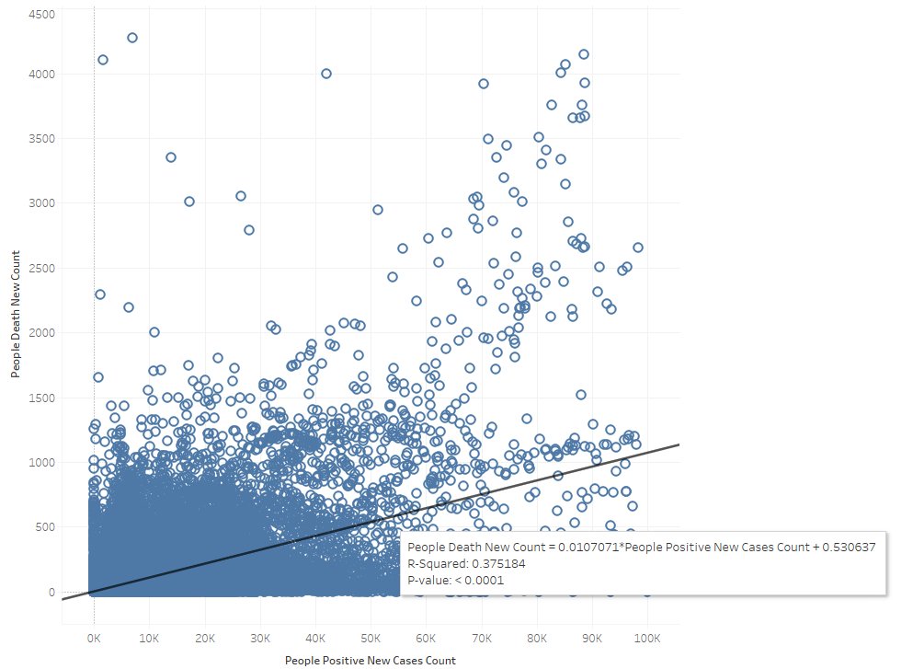
Linear Regression Analysis of Cases vs Deaths
A scatter plot analysis with its regression line demonstrates a 0.375 level of positive correlation between new COVID-19 case counts and death counts. The upward trend shows positive case numbers drive death numbers up while showing substantial variations between the two numbers.

Slide 9
Comparison of Average COVID-19 Cases Before and After Lockdown
This bar chart shows average COVID-19 case numbers significantly rose after the lockdown period ended. After lockdown measures were implemented, the COVID-19 infection rates increased due to either delayed pandemic spread or more active testing and reporting activities.

Slide 10
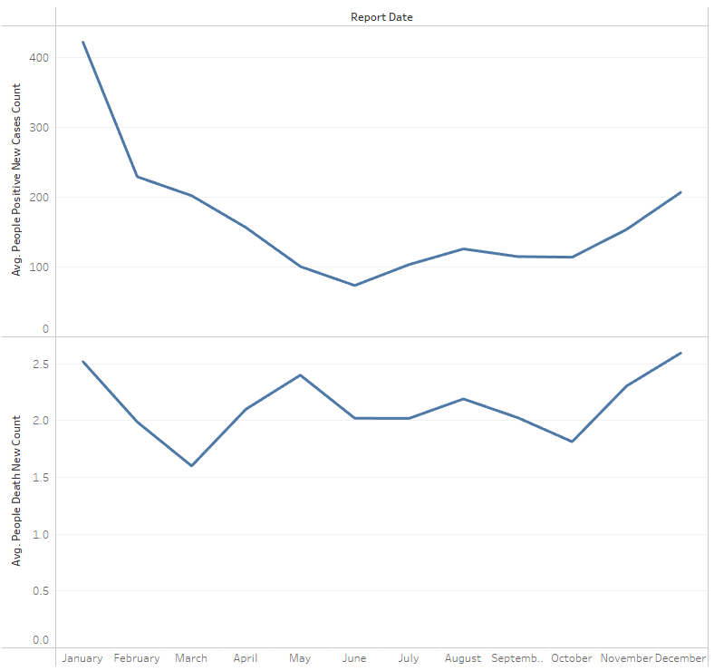
Monthly Trend of Average COVID-19 Cases and Deaths
The chart displays dual lines which demonstrate how average case and death counts decreased from January until mid-year before ascending towards December. The parallel upward movement during year-end indicates seasonal pandemic waves or new waves of infections.

Slide 11
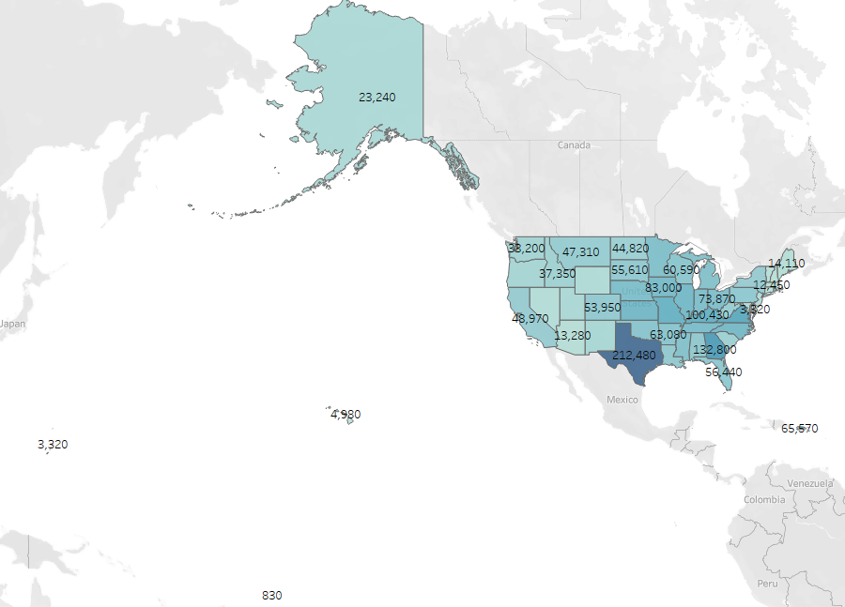
Geographic Spread of COVID-19 Positive Cases in the United States
According to the filled map Texas stands out as the state with the most COVID-19 cases exceeding 212,000. The pandemic shows widespread geographic variation through its portrayal of darkened areas which indicate regions with greater disease totals.

Slide 12
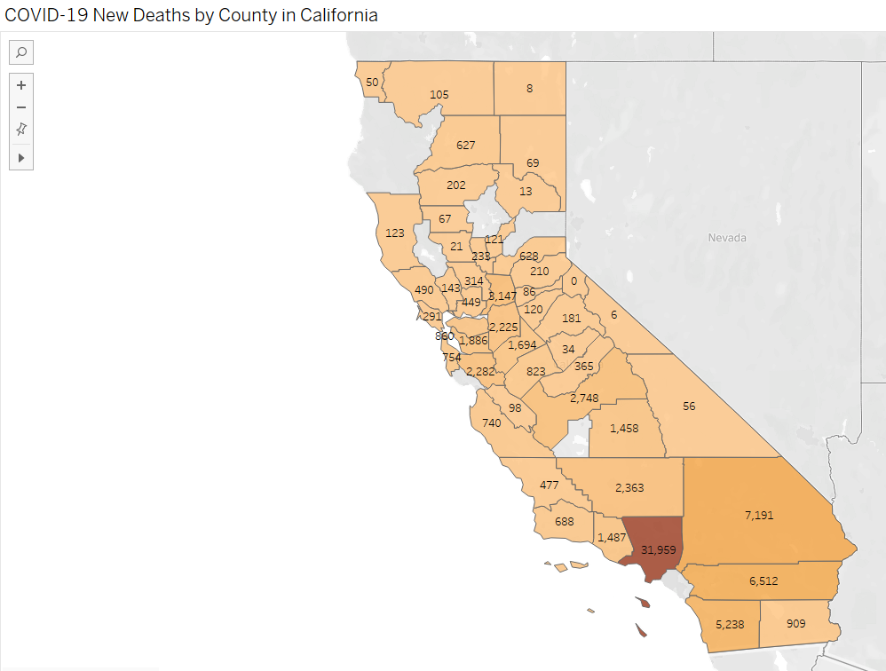
COVID-19 New Deaths by County in California
The filled map indicates California county COVID-19 death counts where Los Angeles County stands out as the location with the most deaths. Regions displaying darker colors indicate higher mortality numbers in order to highlight pandemic severity at specific locations.

Slide 13
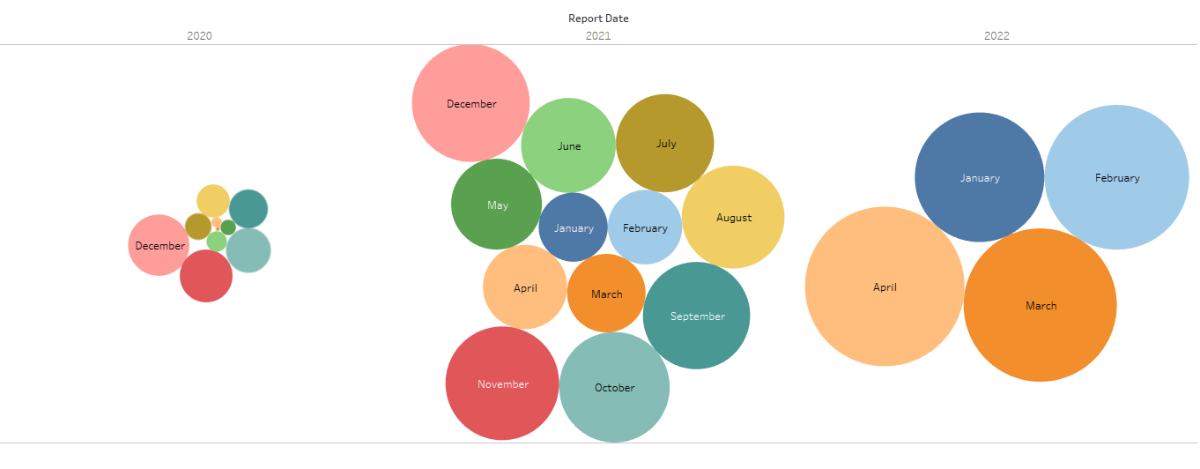
COVID-19 Monthly Case Distribution from 2020 to 2022
The bubble chart depicts COVID-19 new case volumes by size relative to their monthly occurrence between 2020 and 2022. The chart demonstrates case count through bubble size which reveals major outbreaks occurred from December 2021 to March 2022 while cases significantly increased during late 2021 and early 2022.

Slide 14
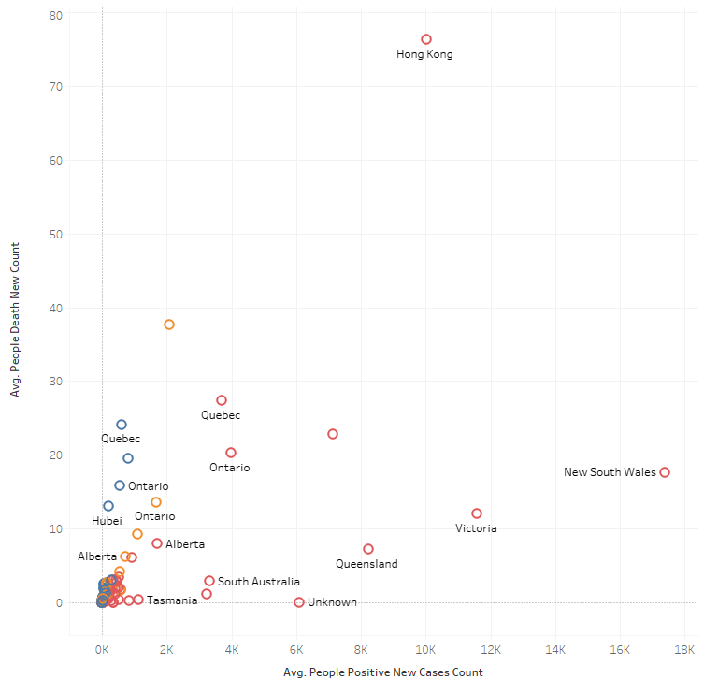
Cluster Analysis of Regions by Average COVID-19 Cases and Deaths
The scatter plot uses clustering to arrange global regions according to their COVID-19 positive case average numbers and death average numbers. Hong Kong together with New South Wales present distinctively high average case and death numbers compared to other regions which maintain lower average values.

Slide 15
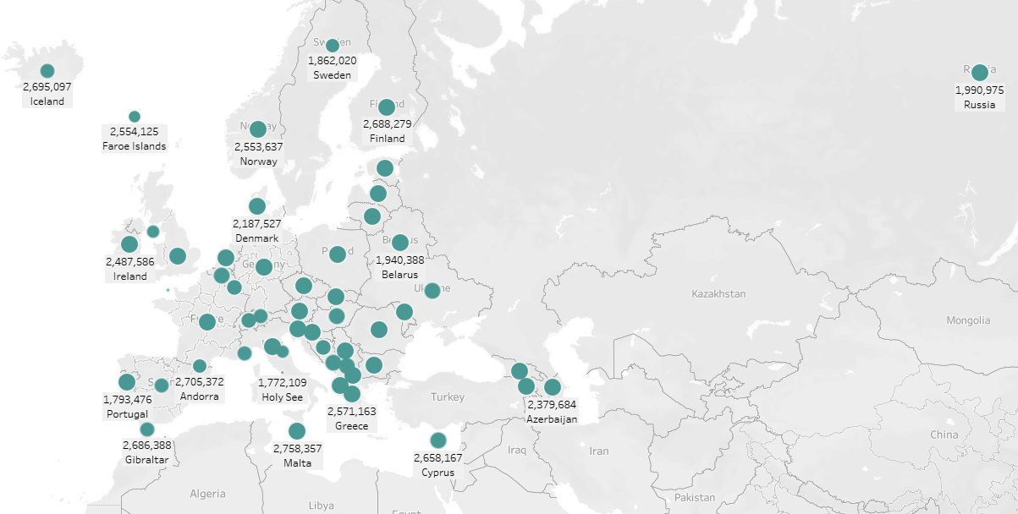
Geospatial Data Distribution of COVID-19 Across Europe
The map displays COVID-19 data distribution in European countries by using circular markers that demonstrate regional metrics. Each region-specific indicator (for example case or death totals) has its representation through marker size and position on this geographic visualization.

Slide 16
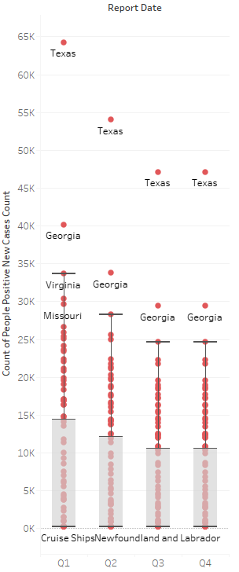
Quarterly Distribution of COVID-19 Case Counts with Regional Outliers
The dot-and-bar chart tracks COVID-19 positive case counts through Q1 to Q4 across Texas, Georgia and Missouri regions. The average quarter counts appear as bar heights but individual regional spikes emerge through dots which expose both outliers and variance.

Slide 17
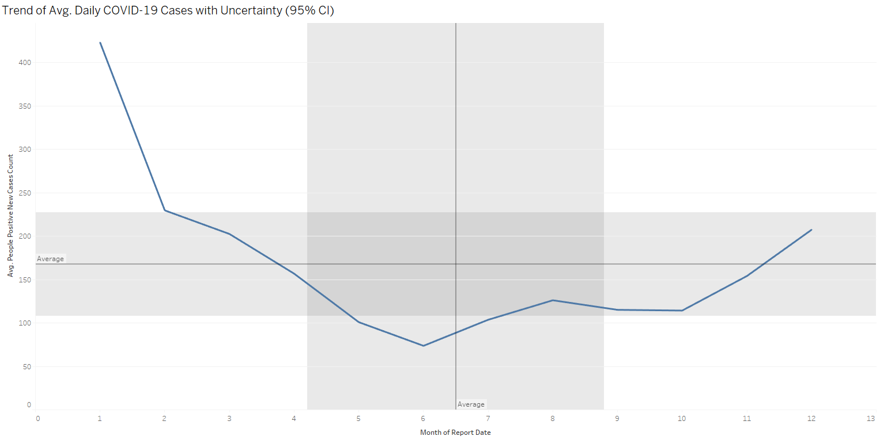
Monthly Trend of Average Daily COVID-19 Cases with 95% Confidence Interval
The monthly changes in average daily COVID-19 cases are shown through this line chart which includes 95% confidence intervals shaded bands. A downward trend in the middle of the year leads to a steady increase which the gray shaded areas show the range of uncertainty surrounding the average pattern.

Slide 18
My work links
https://public.tableau.com/app/profile/shubham.patil2547/viz/Book3_17451372535880/Sheet3?publish=yes – covid 19.

Slide 19
Thankyou!

